Slide 1
Hydrocarbons
organic molecules that contain only hydrogen and carbon
alkanes are the simplest hydrocarbons
covalent molecular structures
low melting and boiling points
non-conductors
solid examples are soft and malleable
insoluble in water

Slide 2
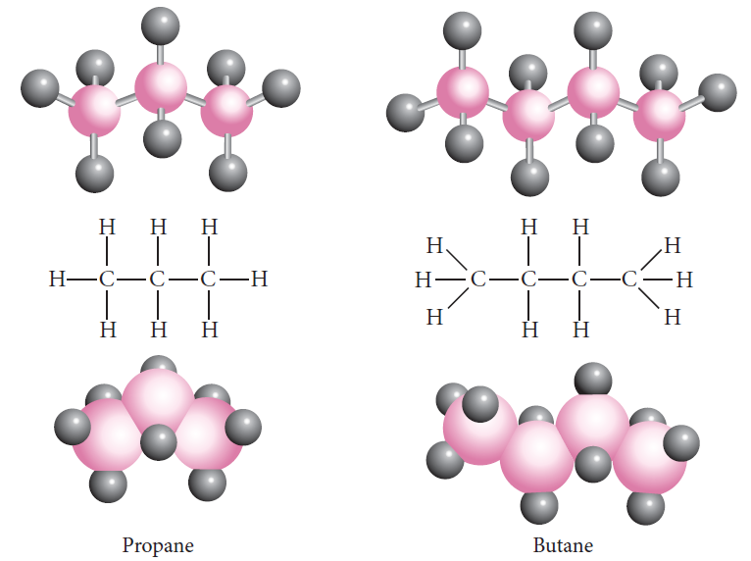
Alkanes
Saturated Hydrocarbons
Only single bonds
Methane CH₄
Ethane C₂H₆
Propane C₃H₈
Butane C₄H₁₀
General Formula C_{n}H_{2n+2}

Slide 3
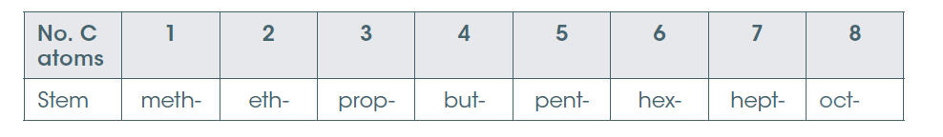
Naming alkanes
The end of the name indicates the group it belongs to e.g. alkanes end in –ane
Determine the longest chain – use the name of the corresponding alkane
Substituents (other atoms or groups) form ‘branches”.
Alkyl group given the ending –yl
F fluoro, Cl chloro, Br bromo, I iodo, NO₂ nitro

Slide 4
Naming alkanes
Number the carbon atoms in the main chain so that the branches have the lowest possible numbers The position of the branch is indicated by this number
e.g. 2-ethyl
List the names of the substituents in alphabetical order. Where there is more than one substituent of the same type, use the prefixes di-(two), tri- (three), tetra –(four), penta-(five) etc.
Note these prefixes are ignored for the alphabetical order
e.g. 3-ethyl, 2,3 dimethyl

Slide 5
Chemical reactivity of alkanes
Alkanes are unreactive.
Combustion
Will burn in oxygen to produce water, carbon dioxide and heat
C₃H₈(g) + 5 O₂(g) → 3 CO₂(g) + 4 H₂O(g)
Substitution
A hydrogen may be replaced with a chlorine or bromine if sufficient energy (UV light) is present
CH₄(g) + Cl₂(g) → CH₃Cl(g) + HCl(g)
This may continue until all the hydrogens are replaced.

Slide 6
Structural isomers
Have the same molecular formula but a different structural formula.
The name of the molecule has be specific enough to allow each isomer to be identified.

Slide 7
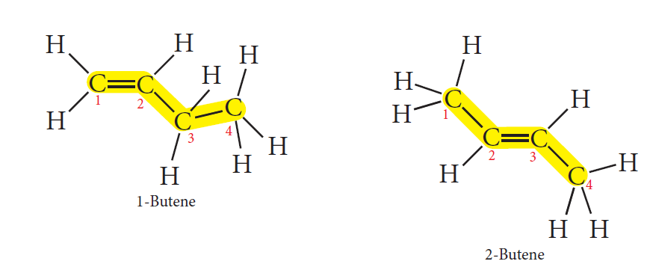
Alkenes
Unsaturated hydrocarbons
One pair of carbon atoms is joined by a double bond
General Formula C_{n}H_{2n}

Slide 8
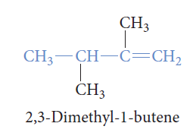
Naming alkenes
Naming similar to alkanes
All compounds in the alkene family have names ending in –ene
the chain containing the double bond is always the main chain
numbering is done from the end of the chain which will give the double bond the lowest number

Slide 9
Chemical reactivity of alkenes
The presence of the double bond makes alkenes very reactive.
The two important reactions are
Combustion
C₄H₈(g) + 6 O₂(g) → 4 CO₂(g) + 4 H₂O(g)

Slide 10
Addition reactions
Reaction with hydrogen
CH₂=CH₂(g) + H₂(g) → CH₃CH₃(g)
Reaction with a halogen
CH₃CH=CH₂(g) + Cl₂(g) → CH₃CHClCH₂Cl(g)
Reaction with water
CH₂=CH₂(g) + H₂O(g) → CH₃CH₂OH(g)
Polymerisation
In the correct conditions long chains – polymers can form.

Slide 11
Addition reactions
When a symmetrical reagent; e.g. H₂ is added the product of the reaction has the same group added to each carbon.
When an asymmetrical reagent; e.g. water, is added to a symmetrical alkene there is only on possible product.
When an asymmetrical reagent; e.g. water is added to an asymmetrical alkene the are two possible products-generally H will go to the carbon with greater number of hydrogens.

Slide 12
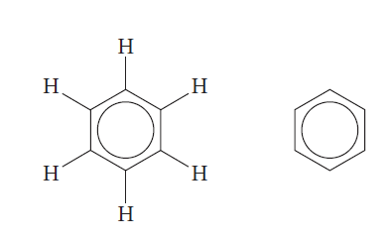
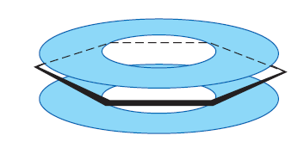
Benzene
aromatic hydrocarbon ‘strong smell’
colourless liquid with a molecular formula C₆H₆
unsaturated molecule
Carbons in a regular hexagon - a six-sided flat ring,
one hydrogen atom is attached to each carbon and a
cloud of delocalised electrons above and below the ring.

Slide 13
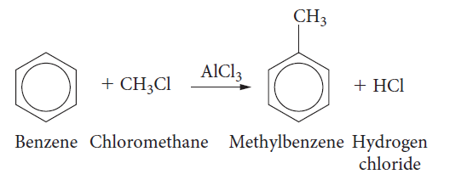
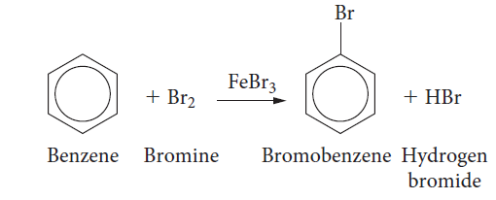
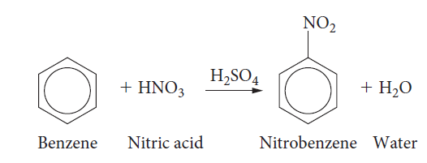
Chemical reactivity of benzene
The cyclic delocalisation of electrons makes benzene extremely stable.
Undergoes Combustion and Substitution reactions
Alkylation
‘Halogenation’
Nitration

